Slide 1


Hack the bay: track 1
Booz Allen Hamilton internal
Amreen gillani
may 2020

Slide 2
The Track
Challenge
Impact of land use and geology to water quality indicators
Case study of how water quality indicators have changed over time
Impact of developments to water quality
Goals of the analysis
Determine trends in water quality using water temperature and pH in LeTort Spring Run.
Identify which external factors could be contributing to changes in water quality indicators.

Slide 3
Approach
The Data
The Process
The Output
Selected water temperature and pH as key water quality indicators to analyze the Letort Spring Run in Pennsylvania
Grouped CMC codes to combine tier 1 with p1, and tier 2 with p2
Tier 1 for water temperature
Tier 2 for pH
6083 samples collected from 2000 – 2020
Identify robust data collection to determine location
In that location, determine where water temperature and pH are experiencing changes over time
Research why water indicators may change
Identify potential external factors contributing to change in water indicators
Time series heat map
Interactive heat map
Time series of “self-identified” hot spots
Notes:
No Tier 2 data for water temperature and scarce Tier 1 data for pH at Letort spring run due to data availability; 3104 – ph; 2979 – water temp

Slide 4
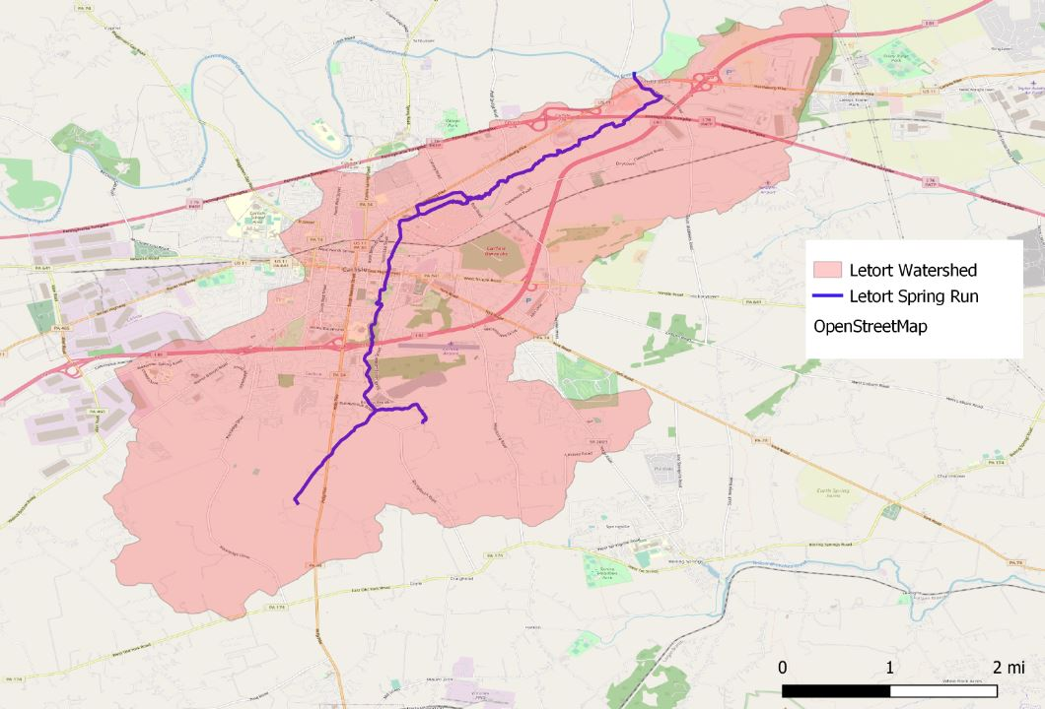
LETORT SPRING RUN
QGIS view using OSM
Watershed²
The LeTort Spring Run is a 9.4-mile-long tributary of Conodoguinet Creek in Cumberland County, Pennsylvania. The LeTort Spring Run is a warm water stream.
According to the Water Research Watershed Center, warm water streams should not exceed 31.667° Celsius¹
pH should be between 6.5 and 8.5 (provided by CMC)
The spring faces problems with pollution and alteration of important wildlife habitats, specifically for about one mile as it flows through Carlisle and part of North Middlesex Township near the heavily-traveled State Route 11, there is urban stormwater pollution and habitat alteration.³
Notes:
Letort Spring run running through Middlesex and Carlisle in PA, includes Conodoguinet Creek above,
Mention that within the watershed, we find areas that are heavily populated, especially city center
PA’s open data website
Watershed whatever is in red goes into the spring

Slide 5
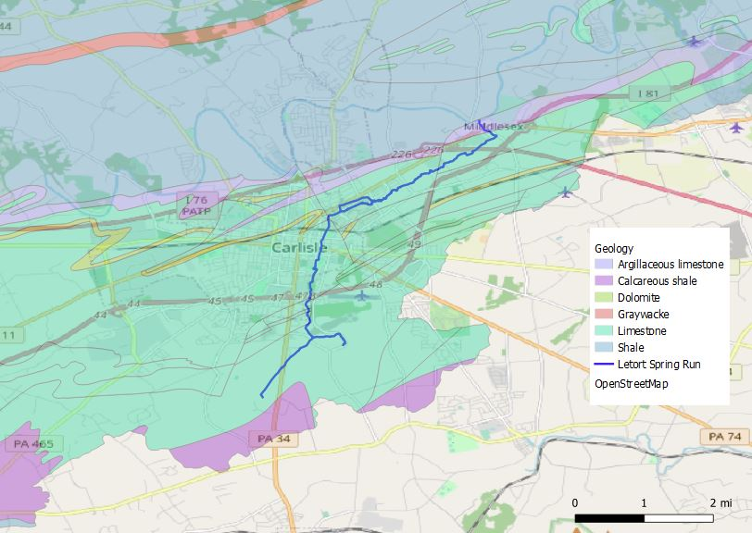
Geology of letort spring run
QGIS view using OSM
Geology⁴
The LeTort Spring Run primarily sits on limestone, which is an alkaline agent used to neutralize acids. We’ll see later on that pH levels are rarely acidic. ⁴
Notes:
Mention that the green area is the limestone, which Letort spring run primarily sits on

Slide 6
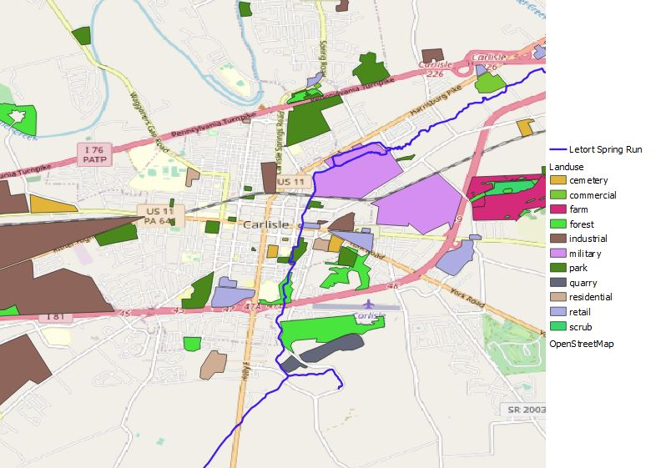
Land use surrounding letort spring run
QGIS view using OSM
The spring runs through the city center of Carlisle, PA.
Using land use shapefiles from OSM, we see the spring runs through a military compound, industrial zones, parks, forests, commercial/retail zones and ends at a quarry before leaving Carlisle.
Notes:
Watershed runoff is passing through all these land use and coming into the river

Slide 7
Water quality: water temperature

Slide 8
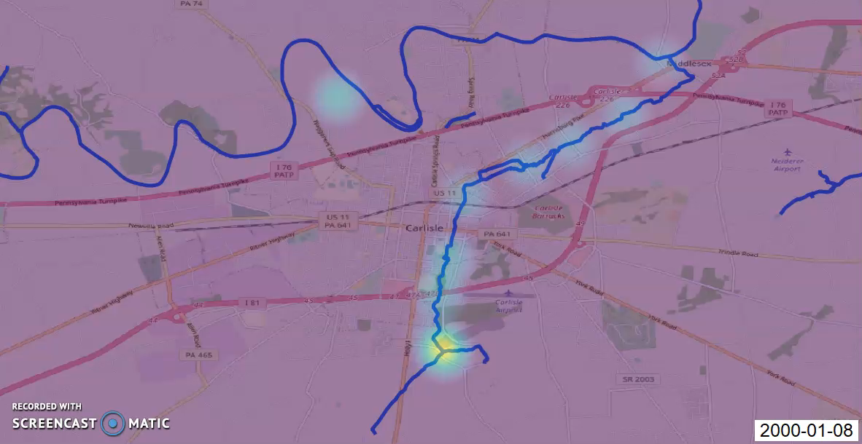
Heat map of water temperature using qgis
Notes:
Using the data in QGIS, open source geographic information systems (GIS) platform, helped identify which areas have a robust data collection consistently over time. Heat map is based on water temperature collected for that day, so if we see it get really bright, it’s hot on that coordinate compared to the rest of the coordinates collected that day

Slide 9
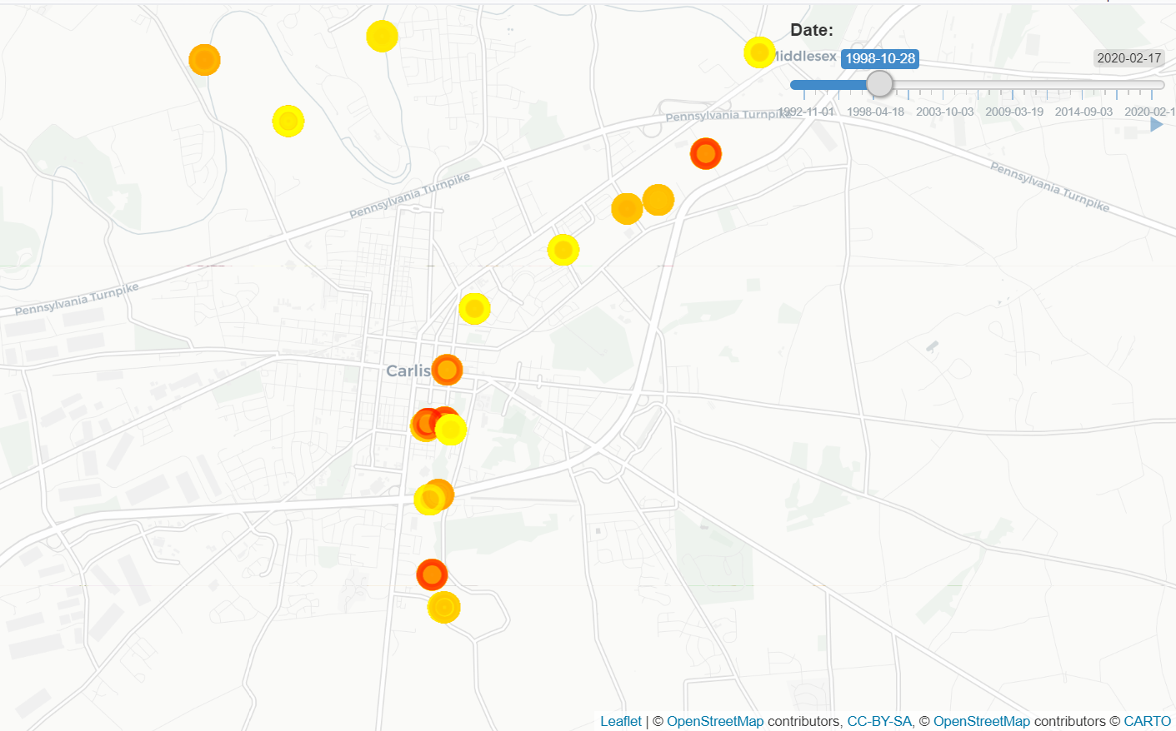
Interactive Heat map of water temperature
Snippet of R Shiny app
To look at specific times of the year, we can use an interactive heat map that allows you to use a slider for dates:
Water temperature
Notes:
Gives you an opportunity to look at location data during specific times of the year
Known issue: Using leaflet with R to create an interactive map does not allow for accuracy in lat longs

Slide 10
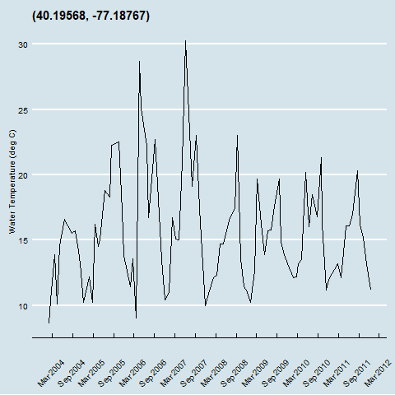
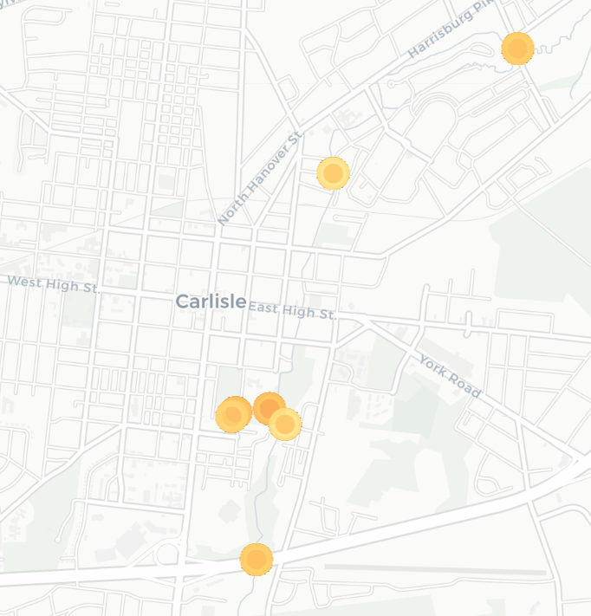
Trending of the hot spots: (40.19568, -77.18767)
One of the coordinates with the hottest temperatures illustrates spikes in water temperature to 25° - 28° Celsius in April-May 2006 and 30° Celsius in June 2007.
.
Notes:
113 data points here; The data drops off in 2011 and there’s one sample in 2017
Point is in the city cednter

Slide 11
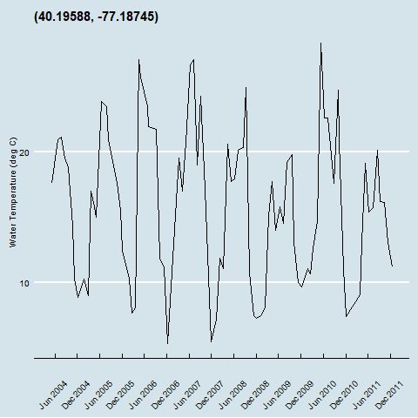
Trending of the hot spots: (40.19588, -77.18745)
There are 2 coordinate sets that are “self-identified” hot spots because they had the hottest temperatures in the data set. The time series of one of the coordinates illustrates possible seasonality spikes in water temperature.
Notes:
85 data points

Slide 12
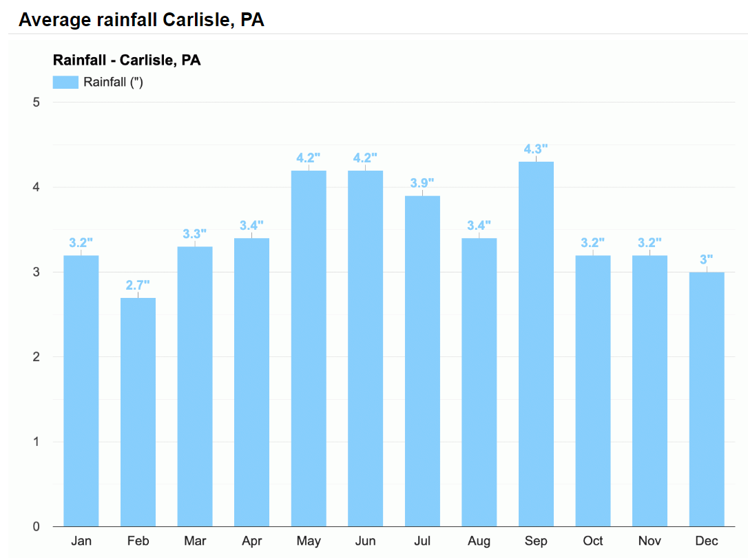
Why would this area have hotter temperatures?
Why?
During the water temperature peaks, it’s possible that it rained in Carlisle⁵ creating runoff on the parking lot, which is an impervious surface where water runs off into the stream harming the water quality.⁶
Notes:
Hot water can shock aquatic life in the stream

Slide 13
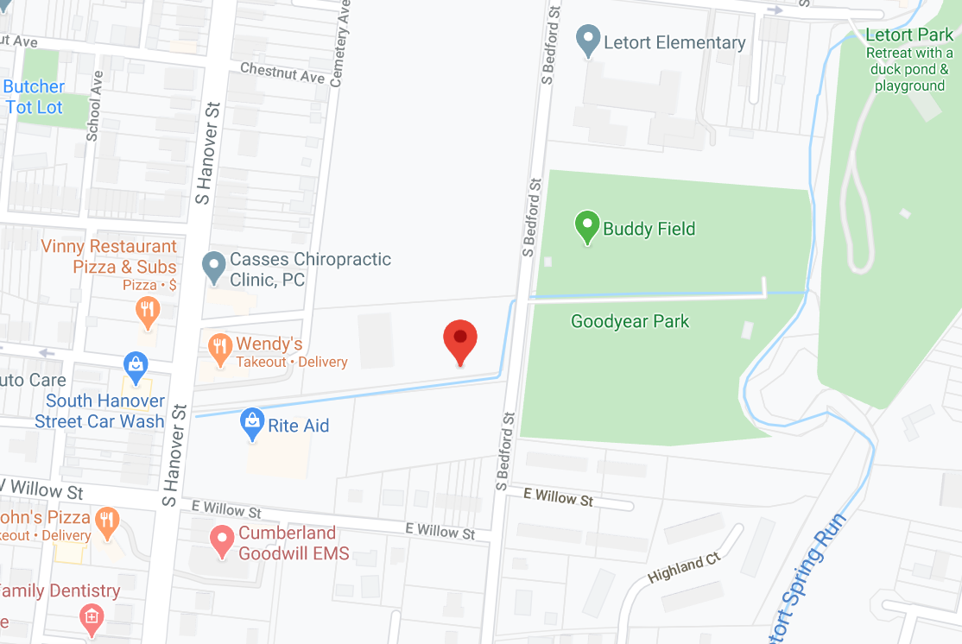
Why would this area have hotter temperatures?
Google Maps
Why?
The water is not part of the upstream or downstream of the spring, so it’s possible that the water is sitting still on a parking lot.
Notes:
Satellite imagery – Google maps

Slide 14
Water quality: pH

Slide 15
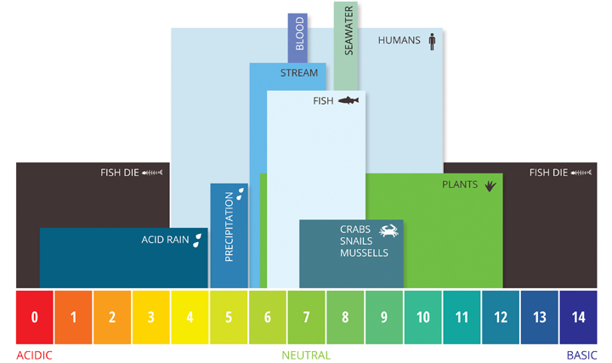
Study of Ph levels
We look at pH in 2 different categories:
Acidic: pH < 6.5
Only 4 samples over 20 years of data
pH is not as acidic at Letort Spring Run because of the limestone that it sits on
Alkaline: pH > 8.5
18 samples over 20 years of data
In the areas where we see high alkaline, there is a quarry that the stream runs through. Quarry dust can change the chemistry of water by dissolving in them.⁷
Notes:
Remember limestone has an alkaline agent that neutralizes the acid
A quarry is a type of open-pit mine in which dimension stone, rock, construction aggregate, riprap, sand, gravel, or slate is excavated from the ground for industrial use.

Slide 16
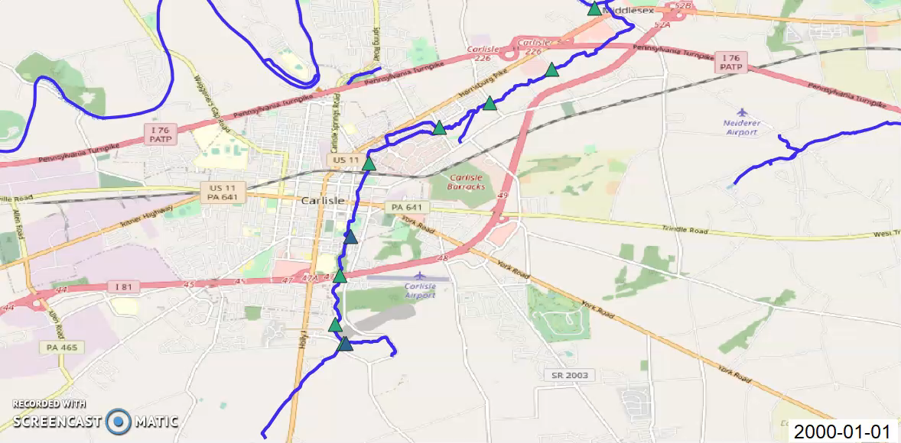
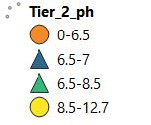
graduated map of ph using qgis
Notes:
Looking for pH outside of the 6.5 – 8.5 range so the areas we’re interested in, we want to look for those circles
We see pH levels spike in multiple areas, however we rarely see pH become acidic in Letort Spring ru

Slide 17
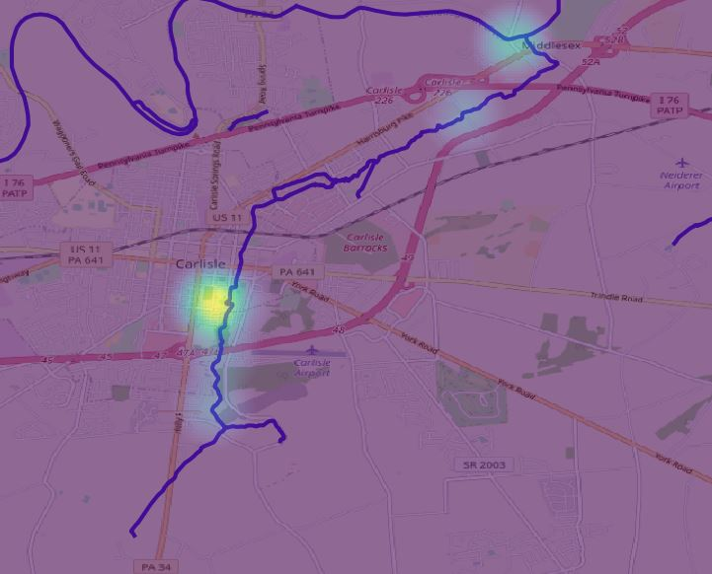
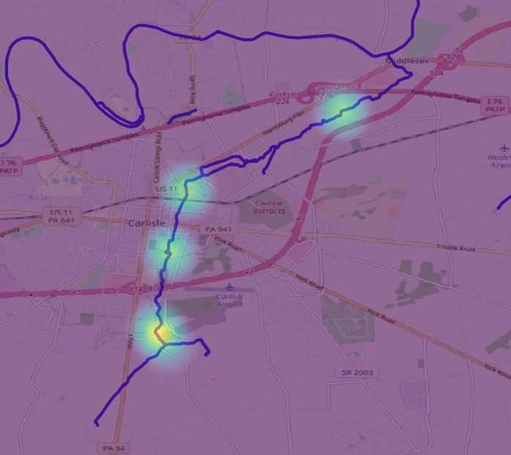
Ph > 8.5 over time made in qgis
2000-2009 2010-2020
Notes:
Let’s look at some static maps! From 2000-2009, there were 9 samples with pH > 8.5, concentrated in a specific area
From 2010-2020, there were 9 samples with pH > 8.5 spread through multiple collection areas

Slide 18
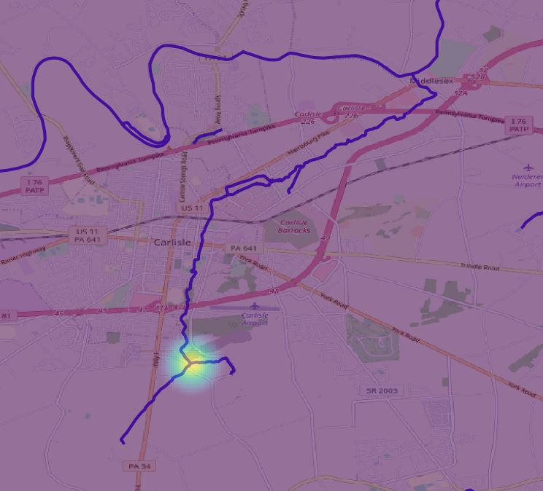
Ph < 6.5 over time made in qgis
2000-2009 No samples from 2010-2020 with pH < 6.5
Notes:
From 2000-2010, there were 4 samples with pH < 6.5, and from 2010-2020, there were 0 samples.

Slide 19
summary

Slide 20
Key findings, Recommendations, limitations
Key Findings
Water temperature does not reach dangerous levels (>31.667° Celsius) in the LeTort Spring Run during 2000-2020 using this specific sample data
pH was not as acidic, but rather had more alkaline in the LeTort Spring Run
Select sample data with high alkaline was sitting near a quarry
Recommendations
To reduce hot water temperature: Create a buffer between the parking lot and the stream with vegetation that will minimize runoff flowing into the stream⁸
To reduce high levels of pH: if quarry has resources, line the quarry with protective soil⁹; if quarry is depleted of resources, working with the city to transform the quarry into a public or private space¹⁰
Limitations
Only used the measurements of water temperature and pH for this analysis
With more time, we could’ve reviewed the notes to help support the narrative
To compare data over time, we would want the same data collection method
For example, the same time of day, same equipment, etc.
Tier 1 and Tier 2 was not consistently available

Slide 21
questions

Slide 22
Resources
https://water-research.net/index.php/stream-water-quality-importance-of-temperature
https://catalog.data.gov/dataset/national-hydrography-dataset-nhd-medium-resolution-nhdwatersheds-pa-clipped
http://www.stormwaterpa.org/cumberland-letort-run-health.html
https://www.dcnr.pa.gov/Geology/GeologyOfPA/Pages/default.aspx
https://www.weather-us.com/en/pennsylvania-usa/carlisle-climate
https://www.usgs.gov/special-topic/water-science-school/science/temperature-and-water?qt-science_center_objects=0#qt-science_center_objects
https://www.quarrylifeaward.com/projects/ghana/impacts-quarry-activities-water-resources-and-effects-biodiversity-odonata-assessment
https://www.epa.gov/heat-islands/using-trees-and-vegetation-reduce-heat-islands
http://www.mit.edu/people/spirn/Public/Ulises-11-308/Quarrying.pdf
https://pubs.usgs.gov/of/2001/ofr-01-0484/ofr-01-0484textonly.pdf
Land use: Open street map (OSM)

